Slide 1
DiffKG: Knowledge Graph Diffusion Model for Recommendation
（WSDM-2024)
https://github.com/HKUDS/DiffKG
Reported by Ke Gan

Slide 2
1. Introduction
2. Approach
3. Experiments

Slide 3
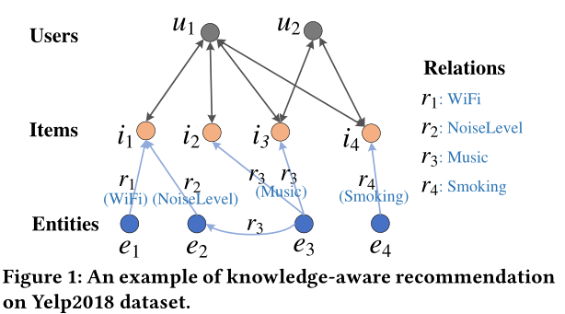
Introduction
not all relations within a KG are equally relevant or beneficial for the target recommendation task.
certain item-entity connections may introduce noise or lack informative value

Slide 4
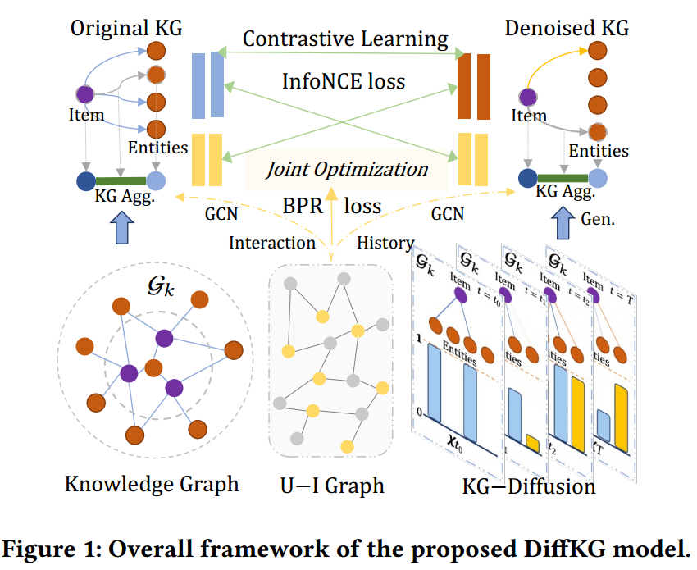
Approach

Slide 5
Approach

Slide 6
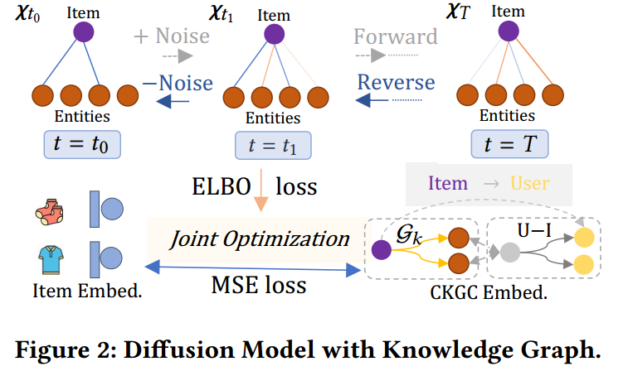
Approach

Slide 7
Approach

Slide 8
Approach

Slide 9
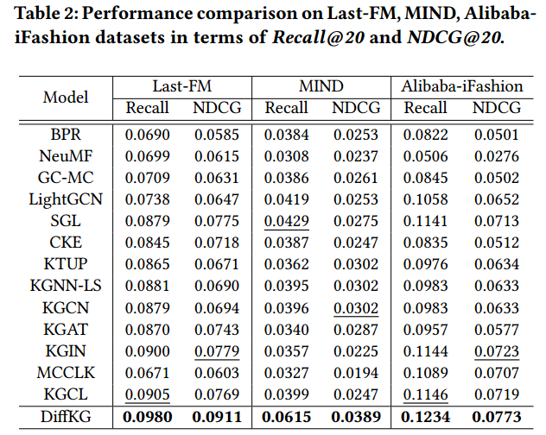
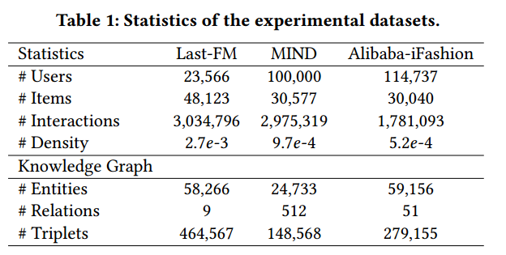
Experiment

Slide 10
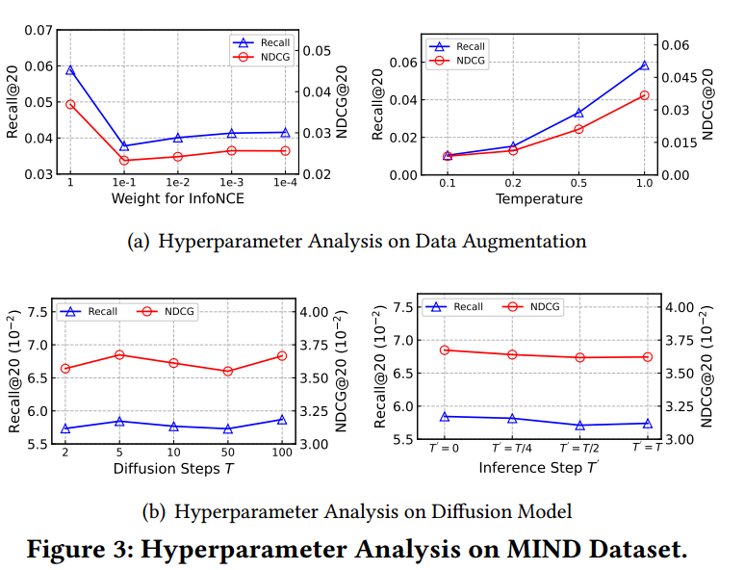
Experiment

Slide 11
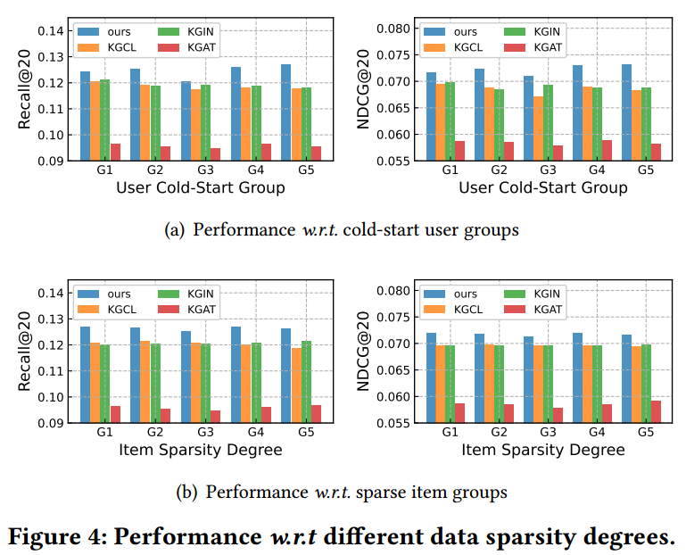
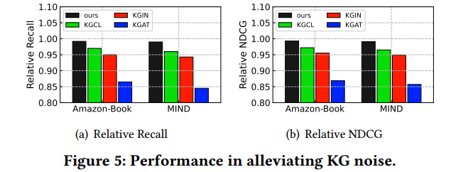
Experiment

Slide 12
Thank you!

